Slide 1
Basic timeseries analysis in Pandas
Stelios Christodoulou
PyData London
June 2025

Slide 2
Basic timeseries analysis in Pandas
autocorrelation_plot()
lag_plot()
.diff()
.autocorr()
Test for randomness and periodicity
Focus on a particular lag identified from the autocorrelation plot
Difference function: highlighting discontinuities, removing “dc components”
Calculate the numerical value for autocorrelation at the particular lag

Slide 3
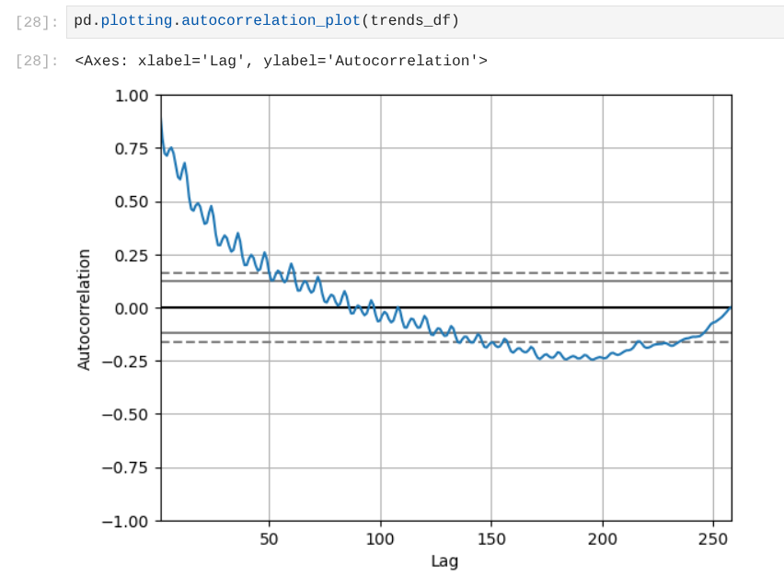
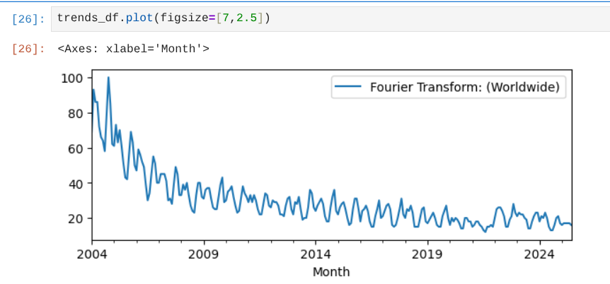
Autocorrelation Plot
Not random
Trend dominates over periodicity

Slide 4
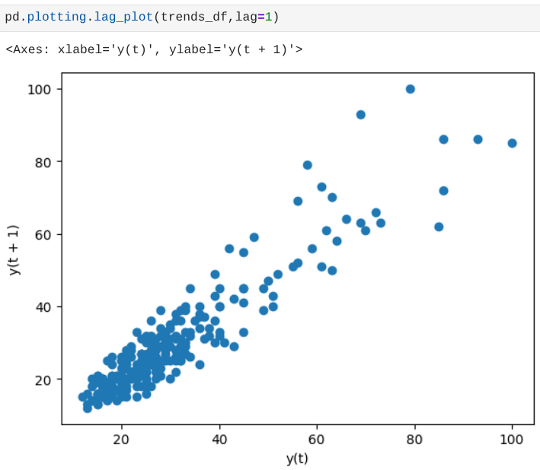
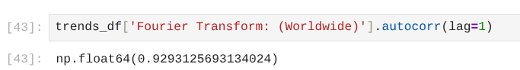
Lag 1 and autocorr
Not random confirmed

Slide 5
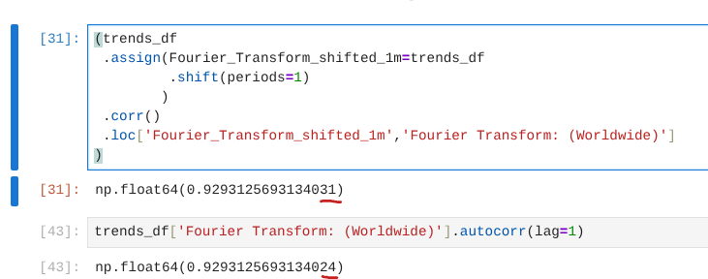
For the computationally minded
Why aren’t the numbers identical?
Which one is correct?

Slide 6
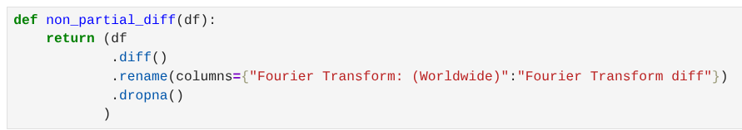
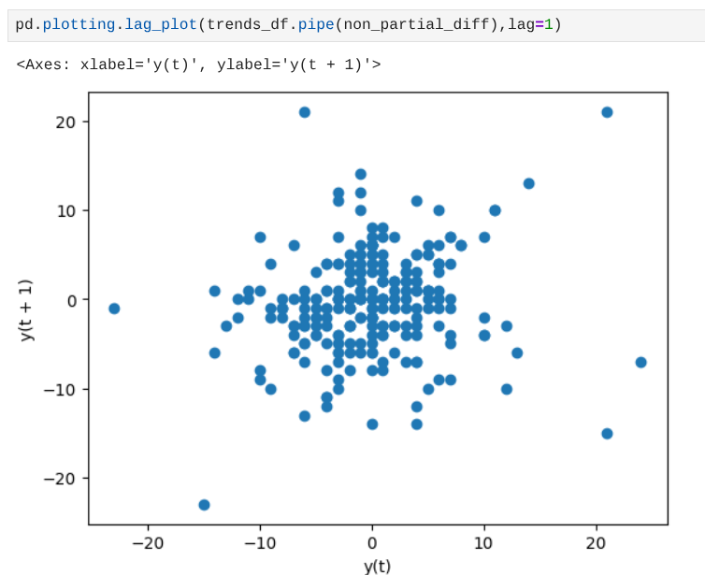
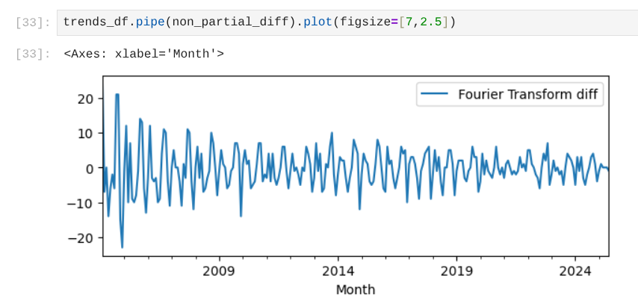
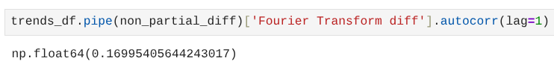
Diff and Lag
Diff makes lag 1 random

Slide 7
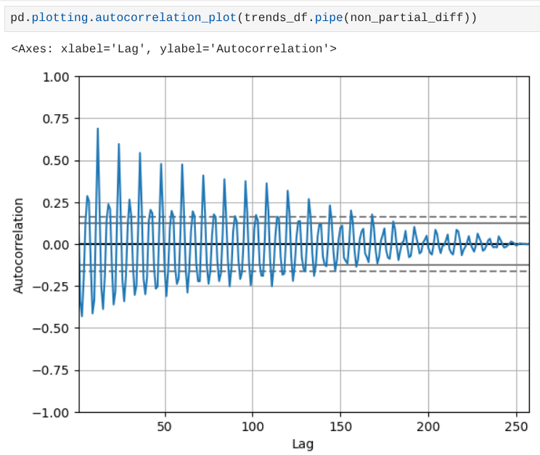
Diff and Autocorrelation
Periodicity comes to the fore

Slide 8
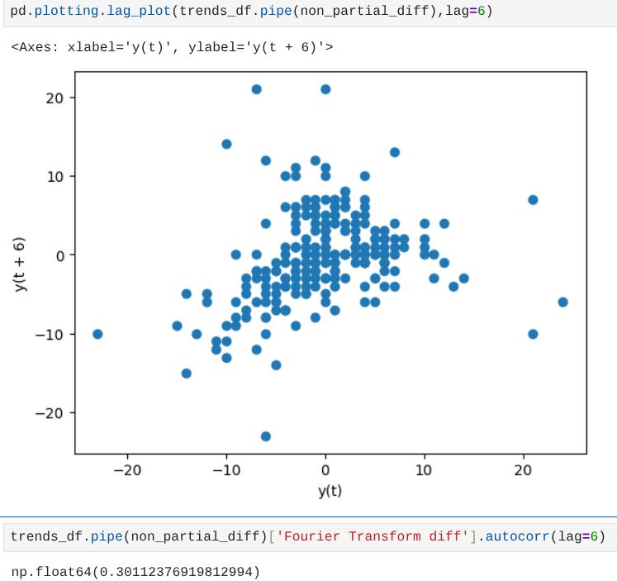
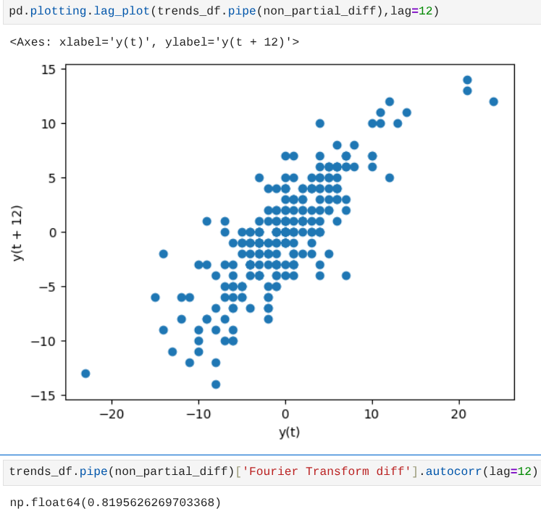
Lag for periodicity
Diff and lag 12 quite correlated
Diff and lag 6 weakly correlated

Slide 9
Thank you
Bibliography
Pandas documentation
NIST/SEMATECH e-Handbook of Statistical Methods
Random Processes chapter in Communication Systems (Haykin)
https://github.com/stelios-c/sig_proc/
Released under the GPL 3.0 Licence.
Inspired from a Linked In post by Kunpeng (KP) Liao.

